Slide 1

What’s the Move? –
Database Analysis
Phillip Stratos, Chris Jones, and Matt Chamberlain
Notes:
Goals and concerns

Slide 2
Database Variables
Users: (Strings): e-mail, establishment_username, regular_username, establishment_password, regular_password, establishment_bio, sunday_deals, monday_deal, tuesday_deals, wednesday_deals, thursday_deals, friday_deals, saturday_deal
Reviews: review_id, e-mail, establishment_reviews, star_rating

Slide 3
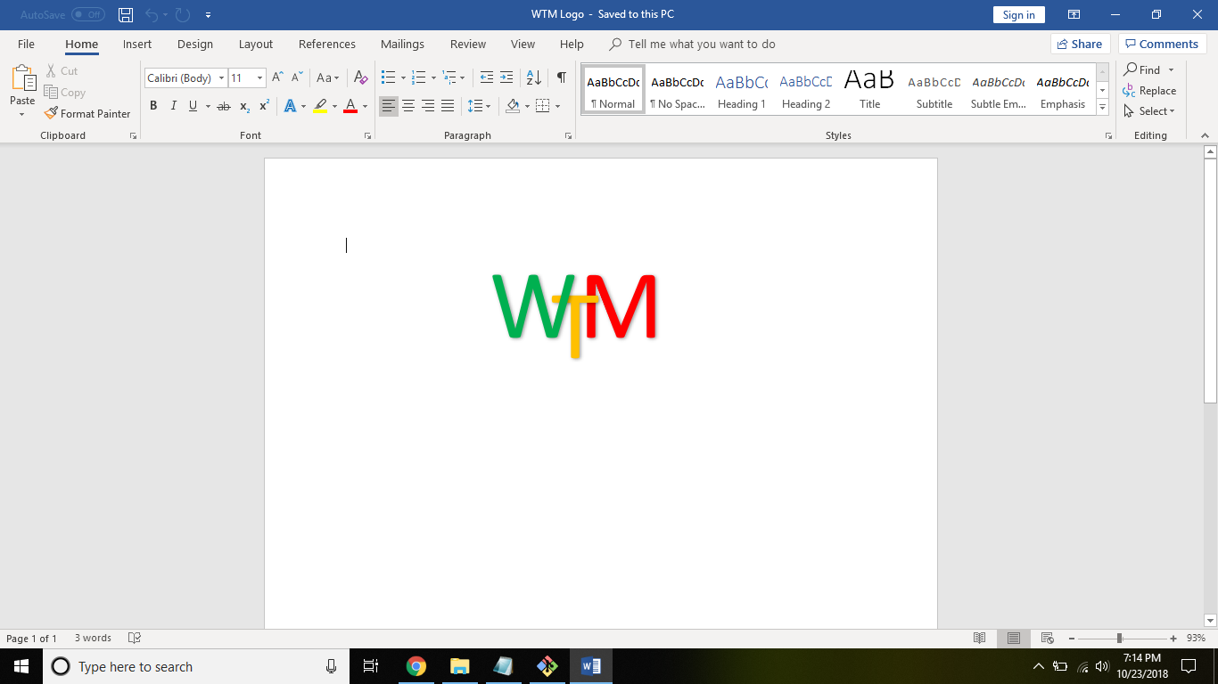

One to Many Relationship ER Diagram
Users
Reviews

